Slide 1


Introduction to Statistics

Slide 2
Course Contents
Data Understanding & Diagnostics
Introduction to Machine Learning
Basic Statistical Concepts

Slide 3
Data Understanding & Diagnostics
Types of data
Data granularity
Measures of central tendency
Measures of dispersion
Univariate analysis
Bivariate analysis
Distributions – Normal, Gamma, Binomial, Poisson, Tweedie

Slide 4
Important Questions to Ask
Have we checked if KPIs* from raw data conforms with our generic business understanding?
What does the data profile look like?
What is the distribution of variables of interest for the analysis?
What key variables are we excluding from the analysis due to non-availability?
What are the unexpected findings on key variables?
*KPI (Key Performance Indicator): A set of quantifiable measures that a company or industry uses to gauge or compare business performance

Slide 5

Types of Data
Data elements describe objects and events and can be classified into different variable types
Variable
Discrete
Continuous
Ratio
Interval
Nominal
Ordinal
What are the different characteristics of a car?
Variable | Values | Type | Description
Brand | Porsche, Toyota, Ford, Cadillac | Nominal | Values cannot be organized in a logical sequence
Model number | AUDI A1, AUDI A3, AUDI A4, AUDI A6 | Ordinal | Values can be logically ordered or ranked
Speed | 90mph, 50m/s | Ratio | Values represent regular intervals which are proportional
Fuel economy | 0-30mph: Average 30-60mph: Economical >60mph: Least | Interval | Sequential order but the intervals are generally irregular

Slide 6
Data Granularity
Understanding granularity of data is critical before performing any operation on the data. Granularity is the relative size, scale, level of detail, or depth of penetration that characterizes an object or activity. Following is an illustration of a data mart:
Data must be stored at some intersection of the dimensions:
Highest level of granularity for storing GEP is by Month/City/Coverage i.e. lowest level in each dimension
Conversely, lowest level of granularity is by Year/Region/Policy i.e. highest level in each hierarchy
Data mart
Gross Earned Premium (GEP)
Time
Year
Quarter
Month
Organization
Region/Zone
State
City
Product
Policy type
Coverage
Granularity makes a difference
Visualizing the data
Identifying the underlying distribution
Testing the spread and central tendency
Histograms
Probability plots
Goodness of fit test
Hypothesis testing
Mean, Median
Percentile distribution

Slide 7
Measures of Central Tendency
Measures of central tendency describe the data series with a single value to represent the center of its distribution
Mean
Also known as average
Calculated by adding all the observations and dividing by the number of observations
3 + 4 + 8 +7 + 5 +3 = 30
30/ 6 = 5
Median
Arrange the data in ascending / descending order
Median splits the data into equal half
1, 2, 4, 5, 6, 8, 9
Mode
The value which occurs with the greatest frequency
There can be more than one mode for a set of observations
1, 2, 2, 5, 6, 6, 9

Slide 8
Measures of Dispersion
Measures of dispersion describe how scattered the values are and how much they differ from the mean value in a dataset
Range
Difference of maximum and minimum value
1, 2, 2, 5, 6, 6, 9
9 – 1 = 8
¯
Standard deviation
Measure the spread in the data when mean is used as the measure of central tendency
S = √ Σ(x- x_{i})²/n
¯
Variance
Variance is a measurement of the spread between the data set values. Variance measures the distance of each number in the data set from the mean
σ² = Σ(x- x_{i})²/n

Slide 9
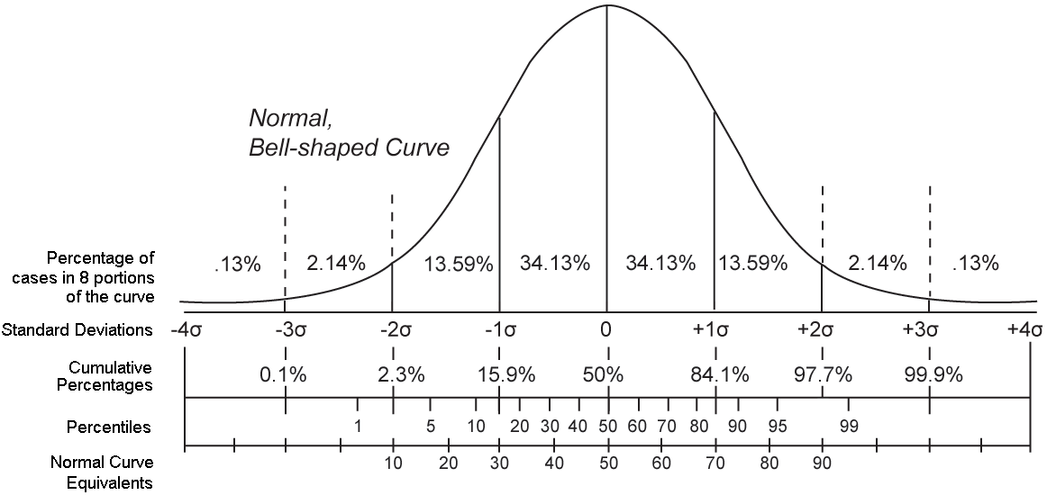
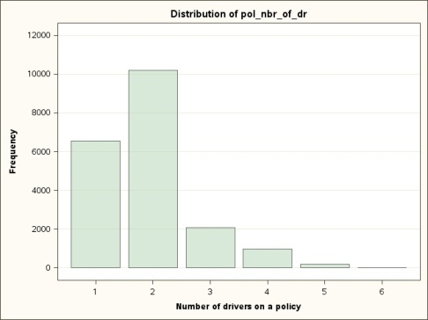
Univariate Analysis
Univariate analysis provides basic descriptive statistics about a single variable
Continuous Variable
Measures of central tendency
Measures of dispersion
Higher moments (Skewness, Kurtosis)
Percentile values
Discrete Variable
Frequency of a level
Percentage distribution
Levels in data

Slide 10
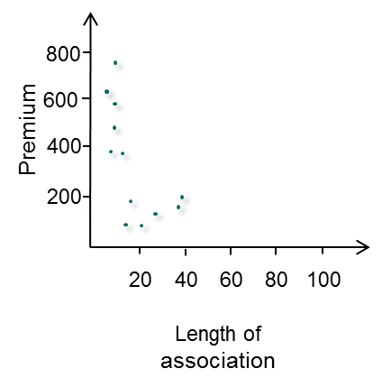
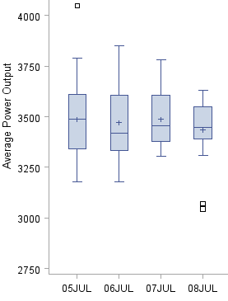
Bivariate Analysis – Graphical Study
Bivariate analysis is used to analyze the relationship between two variables
Continuous vs. Continuous
Discrete vs. Continuous
Discrete vs. Discrete
Scatter plot represents both variables in a 2-dimensional graph
Box plots are used to assess the association between discrete and continuous variables
Two way frequency table is used to assess the association between two nominal variables
Color | Size
 | Small | Big
Red | 10 | 90
Green | 90 | 10
Deciling can be used to study the association between continuous variables without a scatter plot
Day (discrete)

Slide 11
Bivariate Analysis – Quantitative Study
Correlation coefficient describes the strength of linear relationship between two variables
Continuous vs. Continuous
Discrete vs. Continuous
Discrete vs. Discrete
Pearson correlation coefficient
Spearman’s rho
Cramer’s V
Measures the direction and strength of linear relationship between two quantitative variables
Strong correlation : close to -1 and 1
Weak correlation : near zero
Measures the strength of relationship between an ordinal variable and a quantitative one
Avoids assumptions that the variables have a linear relationship
Ranges between -1 and 1
A value of 0 indicates no relationship while values of +1 or ­1 indicate high correlation
It is a measure of association between two nominal variables
Ranges between 0 and 1
A value of 0 indicates no relationship and value of +1 indicates high correlation

Slide 12
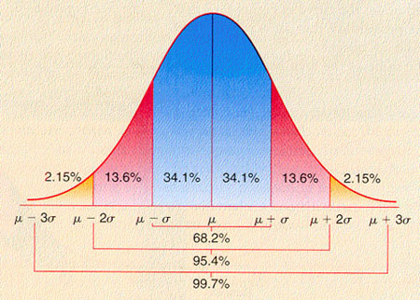
Introduction and Normal Distribution
Properties of Normal Distribution:
X~N(μ, σ)
Called ‘normal’ because it’s deemed ideal
Normally expected to be seen for a lot of continuous data
Shape: bell curve.
The greatest probability density is around the mean, so values around here are most likely
The further you get from the mean, the lower the probability density
μ tells you where the center of the curve is
As σ² gets larger, the flatter and wider the normal curve becomes
σ² indicates the spread of values
Notes:
The normal distribution is called normal because it’s seen as an ideal. It’s what you’d “normally” expect to see in real life for a lot of continuous data such as measurements.
The normal distribution is in the shape of a bell curve. The curve is symmetrical, with the highest probability density in the center of the curve. The probability density decreases the further away you get from the mean. Both the mean and median are at the center and have the highest probability density.
The normal distribution is defined by two parameters, μ and σ2. μ tells you where the center of the curve is, and σ gives you the spread. If a continuous random variable X follows a normal distribution with mean μ and standard deviation σ, this is generally written X ~ N(μ, σ2 ).
Shape of normal distribution:
μ tells you where the center of the curve is
σ² indicates the spread of values
As σ² gets larger, the flatter and wider the normal curve becomes.

Slide 13
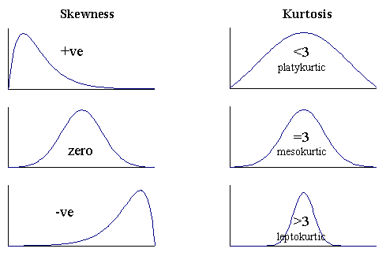
Skewness and Kurtosis
A fundamental task in many statistical analysis is to characterize the location and variability of data. Skewness & Kurtosis measures describe the shape of the distribution
Skewness: describes how the sample differs in shape from a symmetrical distribution
If a normal distribution has a skewness of 0, right skewed is greater then 0 and left skewed is less than 0
Kurtosis measures the extent to which the data are distributed in the tails versus the center of the distribution
There are three types of Kurtosis
Leptokurtic- Very Peaked (+ve Kurtosis)
Platykurtic – Relatively Flat (-ve Kurtosis)
Mesokurtic – In Between (0 Kurtosis)
Both skewness and kurtosis are sensitive to outliers and differences in the mean

Slide 14
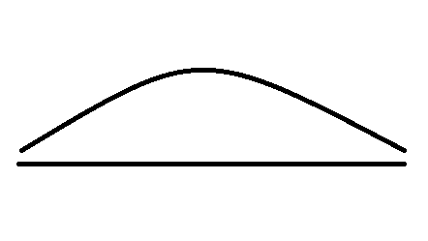


Male Modeling
The taller than average people are in this area
The people of average height are in this area
The shorter than average people are in this area
This shape of distribution is actually fairly common and can be applied to lots of situations. It’s called the Normal distribution.
Notes:
So far we’ve looked at very simple continuous distributions, but it’s unlikely these will model the heights of the men Julie might be dating. It’s likely we’ll have several men who are quite a bit shorter than average, a few really tall ones, and a lot of men somewhere in between. We can expect most of the men to be average height.

Slide 15
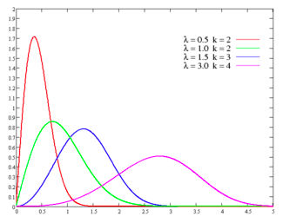

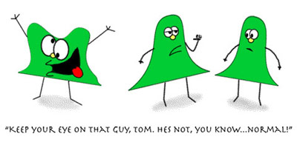

Gamma Distribution
Representation of monthly rainfall in Africa for drought monitoring applications
What do you think a sample rainfall data would be like?
What do you think the Distribution would look like? Will it be Normal?
The Gamma Distribution
I rain only during the 1 month of monsoon and a few freak showers here and there
Rest of the year I don't rain at all
Mean = kλ and variance =${kλ}^{2}$
Notes:
P(X=x) = $\frac{1}{Ґ(θ)}∗{\left(\frac{θ}{μ}\right)}^{2}∗y^{θ−1}∗ e^{\frac{y∗θ}{μ}}$
Evaluating a range of scenarios that accurately reflect precipitation variability is critical for water resource applications
Inputs to these applications can be provided using location- and interval-specific probability distributions
These distributions make it possible to estimate the likelihood of rainfall being within a specified range
What do you think the Distribution would look like? Will it be Normal?
k: shape parameter λ: scale parameter
When data is not symmetrical, we need to look for other Distributions that can be appropriate for skewed data
The gamma distribution is such an alternative to consider. It can be explained using 3 parameters: shape, shift and scale
Increasing the shape parameter will push the distribution towards the left, at high values of sigma, the left tail disappears entirely and the outliers are all positive

Slide 16
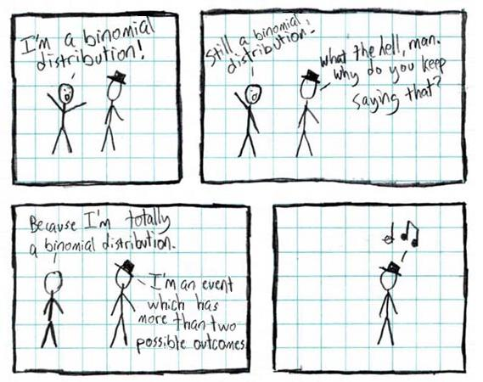
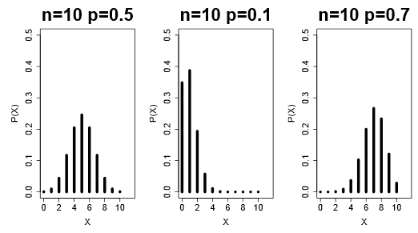
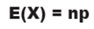
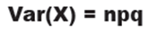
Binomial Distribution
The binomial distribution measures the probabilities of the number of successes over a given number of trials
Characteristics of Binomial Distribution
Independent trials
Only 2 possible outcomes – success or failure
Constant probability for each trial
Finite number of trials
Mean and Variance
Shape of Binomial Distribution
Symmetric
Positive skew
Negative skew
Notes:
Characteristics:
The Binomial distribution occurs where
You’re running a series of independent trials
There can be either a success or failure for each trial, and the probability is the same for each trial
There are finite number of trials
Shape:
The exact shape of the binomial distribution varies according to the values of n and p.
The closer to 0.5 p is, the more symmetrical the shape becomes.
In general it is skewed to the right when p is below 0.5, and skewed to the left when p is greater than 0.5.

Slide 17
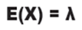
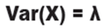
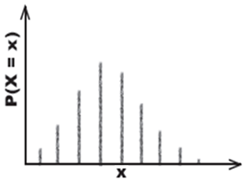
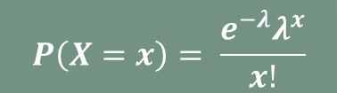
Poisson Distribution
Situations covered by Poisson Distribution
$$P\left(X=x\right)= \frac{e^{−λ}λ^{x}}{x!}$$
Mean and Variance
Individual events occurring at random and independently in a given interval.
Mean number of occurrences in the interval or the rate of occurrences is known, and it's finite.
X~B(n,p) can be approximated by X~Po(np) if n is large and p is small
What does the Poisson Distribution look like?
The shape of the Poisson Distribution varies depending on the value of λ
Sometimes it’s simpler to use the Poisson distribution than the binomial
Suppose n= 3000 - then at some point you’ll have to calculate 3000
Notes:
Situations covered by Poisson Distribution
Individual events occur at random and independently in a given interval. This can be an interval of time or space—for example, during a week, or per mile.
You know the mean number of occurrences in the interval or the rate of occurrences, and it's finite. The mean number of occurrences is normally represented by the Greek letter A (lambda)
In the formula X = number of occurrences in the given interval
What does the Poisson Distribution look like?
The shape of the Poisson Distribution varies depending on the value of λ
Sometimes it’s simpler to use the Poisson distribution than the binomial
Suppose n= 3000.
Then at some point you’ll have to calculate 3000!

Slide 18
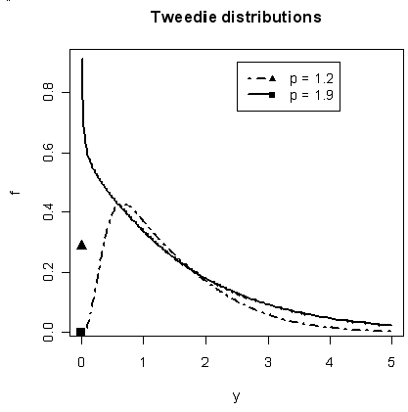
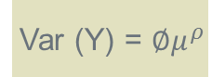
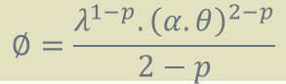
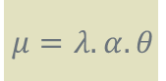
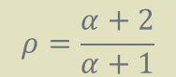
Tweedie Distribution
The Tweedie family of distributions are a three-parameter family (the normal and gamma are two-parameter families), and therefore permit modelling flexibility
Combines discrete and continuous distributions
For any random variable Y that obeys a Tweedie distribution
Where ∅ is the scale parameter µ is the expected value of LC 𝜌 is an index parameter
These parameters determine the shape of the Tweedie distribution. The normal, Poisson and gamma distributions are special cases of the Tweedie distribution
$$ρ=\frac{α+2}{α+1}$$
$$μ=λ.α.θ$$
$$∅=\frac{λ^{1−p}.{\left(α.θ\right)}^{2−p}}{2−p}$$
Var (Y) = $∅μ^{ρ}$
For various values of p, the following distributions exist:
p=0: normal distribution
p=1: Poisson distribution
1< p< 2: for continuous data with exact zeros
p=2: gamma distribution
p>2: for positive continuous data
Notes:
https://www.casact.org/education/annual/2009/handouts/c25-meyers.pdf
Reference for formulae: Page number 1596
http://books.google.co.in/books?id=OE0UfAhit4kC&pg=PA1596&lpg=PA1596&dq=tweedie+distribution+index+and+scale+parameters&source=bl&ots=pfKtuokeXq&sig=GT4i-FekDuTAYzx-wmb0J8ZrUrI&hl=en&sa=X&ei=67smU-PbC8qlrQeLr4HIDQ&redir_esc=y#v=onepage&q=tweedie%20distribution%20index%20and%20scale%20parameters&f=false

Slide 19
Introduction to Machine Learning
What is Machine Learning?
Real world use cases
Types of ML algorithms and their applications
Pros/cons of using Machine Learning

Slide 20
What is Machine Learning?
Traditional Computing
Data
Computer
Program/
Algorithm
Output
Machine Learning
Data
Computer
Program/
Algorithm
Output
Machine learning is all about feedback
Use of self learning Algorithms to make sense of data
Solve problems with huge data sets (e.g. click data) or absurd complexities (e.g. voice recognition)
Notes:
Use of self learning Algorithms to make sense of data
Solve problems with huge data sets (e.g. click data) or absurd complexities (e.g. voice recognition)

Slide 21
Components and Build
LEARNING REPRESENTATION + EVALUATION + OPTIMIZATION
What we know about what we know
What we want to know about what we do not know
Data
Noise
Seeing is believing
Measuring what we want against what we have
Object. Subject
Remove noise
Don’t take what is not relevant

Slide 22

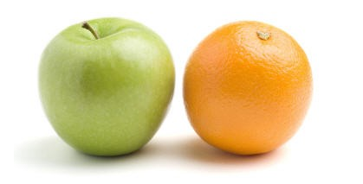
How Many Ways Can You Recognize an Apple?
Example | Attribute
Apple 1 | Has a leaf
Apple 2 | Red
Apple 3 | Has a stalk
….
Apple N | More edges
Example | Attribute
Orange 1 | Orange
Orange 2 | More circular
…..
Orange N | No edges
Notes:
Getting a computer to do or predict stuff by giving it examples.

Slide 23
Machine Learning vs. Statistics Debate
Statistics is the study of the collection, organization, analysis, interpretation and presentation of data
Machine learning is a branch of AI concerning the construction and study of systems that can learn from the data.
Theory
Discovery
Statistics
Machine
Learning
Deductive
Inductive
Inference
Learning
Experiment Design
Generalization
Sampling
Numerical
Math / Stat / Econ
Computer Science
Mapping functions are important but features are the differentiating factor
Notes:
http://blog.revolutionanalytics.com/2009/09/the-difference-between-statistics-and-machine-learning.html

Slide 24
Machine Learning vs. Statistics Debate
Factor analysis
Linear regression
GLM*
Cluster analysis
Logistic regression
GDA*
Mixed model
Correspondence analysis
Principal component
GAM*
Survival analysis
Non- linear estimation
Discriminant
ANOVA/MANOVA
Statistics
EM* algorithm
Canonical analysis
Vector Autoregression
Time series forecasting
Boosted tree
Bagging
Machine Learning
Regression tree
GBM*
Naive Bayes
Nearest neighbor
Random forest
Self Organizing Map
Neural network
Bayesian network
Support vector machine
Fuzzy clsutering
Vector quantization
Fuzzy networks
Restricted Boltzmann machines
Bootstrap
GAM – Generalized Additive Model, GLM – Generalized Linear model, GDA – Gaussian Discriminant analysis, GBM – Gradient Boosting Machine, EM – Expectation Maximization
Notes:
High computing power and custom technology solutions have made deployment of complex computing techniques easier

Slide 25
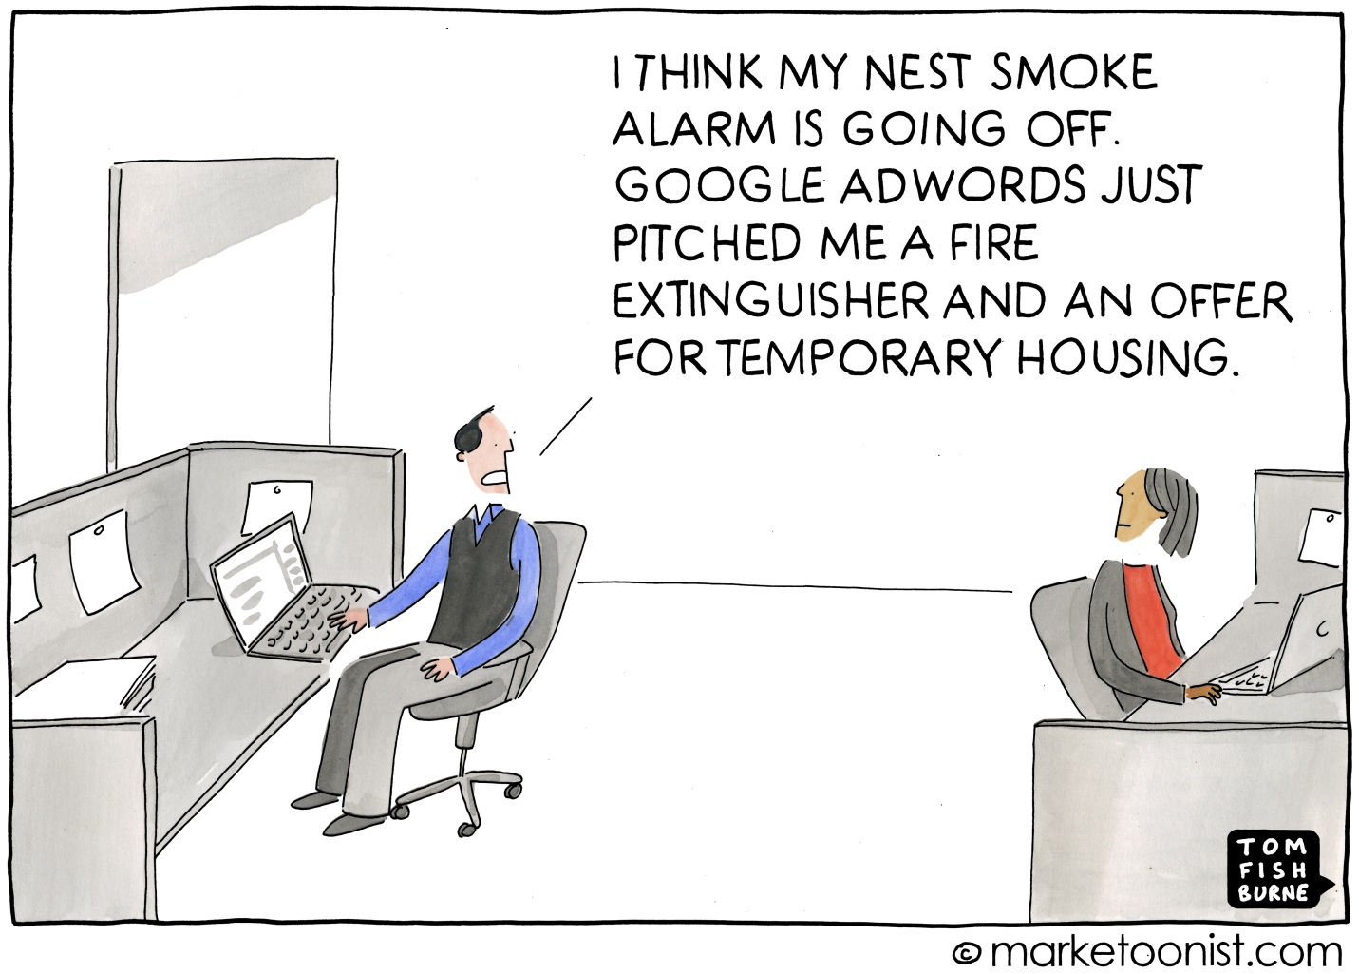
Real World Use Cases
509
Companies on CrunchBase
Source: The Current State of Machine Intelligence http://www.shivonzilis.com/machineintelligence

Slide 26
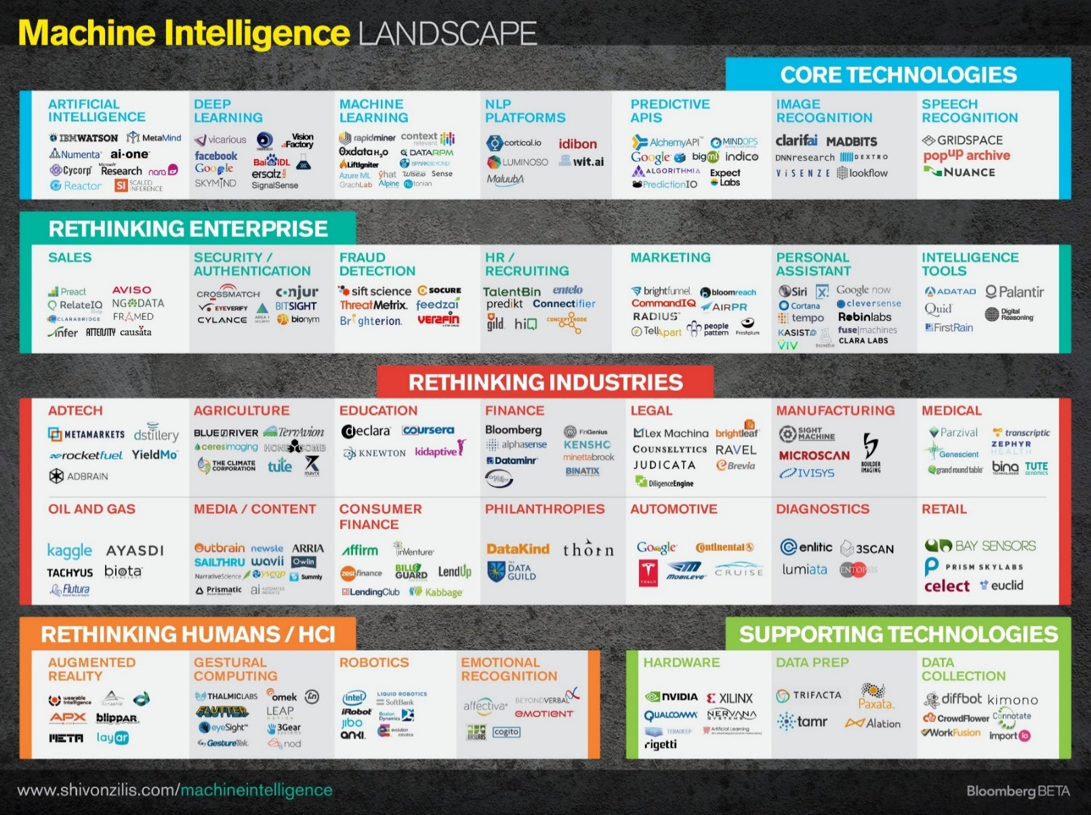
Tech 2015: Deep Learning And Machine Intelligence Will Eat The World
Notes:
http://www.forbes.com/sites/anthonykosner/2014/12/29/tech-2015-deep-learning-and-machine-intelligence-will-eat-the-world/

Slide 27
Types of Machine Learning Techniques
Supervised Learning
Unsupervised Learning
Classification
Clustering
Discrete
Regression
Dimension Reduction
Continuous

Slide 28
Types of Machine Learning Techniques
Supervised Learning
Unsupervised Learning
Classification
Clustering
Naïve Bayes
Decision Tree
Support Vector Machine
Logistic regression
Random Forest
K- Means
Hierarchical
DBSCAN
Neural Nets
Discrete
Regression
Dimension Reduction
Linear Regression
Multinomial Regression
Elastic Net Lasso
Ridge Regression
Principal Component Analysis
Kernel Approximation
Independent Component Analysis
Continuous

Slide 29
ML Techniques – Classification
Classification is the problem of identifying to which of a set of categories (sub-populations) a new observation belongs, on the basis of a training set of data containing observations (or instances) whose category membership is known.
Linear classifier – Naïve Bayes, Logistic Regression, Fisher's linear discriminant, Perceptron
Support vector machines – Least squares SVM, Multiclass SVM, Transductive SVM
Kernel estimation – K near
Boosting methods – adaptive boosting
Decision tree classifier – Ensemble methods (bagging, boosting, random forest)
Neural Networks

Slide 30
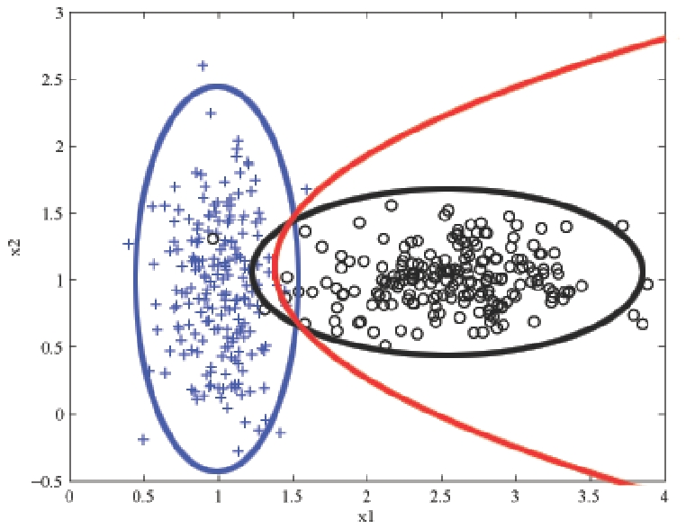
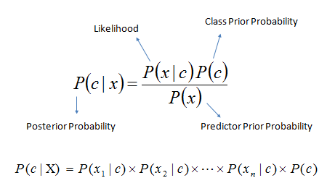
Example of a Classifier: Naïve Bayes
Naive Bayes classifiers are a family of simple probabilistic classifiers based on applying Bayes' theorem with strong (naive) independence assumptions between the features
Bayes' Theorem
2D binary classification with Naive Bayes. A density contour is drawn for the Gaussian model of each class and the decision boundary is shown in red.
Notes:
Source: http://learning.cis.upenn.edu/cis520_fall2009/index.php?n=Lectures.NaiveBayes

Slide 31

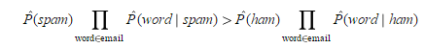
Example of Naïve Bayes
Gaussian Naïve Bayes
Multinomial Naïve Bayes
Bernoulli Naïve Bayes
Semi supervised parameter estimation
Notes:
https://en.wikipedia.org/wiki/Naive_Bayes_classifier

Slide 32
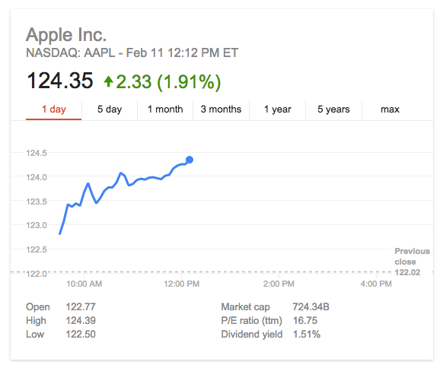
ML Techniques – Regression
Regression analysis is a statistical process for estimating the relationships among variables. It includes many techniques for modeling and analyzing several variables, when the focus is on the relationship between a dependent variable and one or more independent variables (or 'predictors')
Linear regression
Lasso regression
Elastic Net regression
Least Angle regression
Multivariate Adaptive Regression Splines

Slide 33
ML Techniques – Dimensionality Reduction
Dimensionality reduction is the process of reducing the number of random variables under consideration
Feature selection approaches try to find a subset of the original variables (also called features or attributes)
Feature extraction transforms the data in the high-dimensional space to a space of fewer dimensions.
Benefits of Dimension reduction:
It reduces the time and storage space required.
Removal of multi-collinearity improves the performance of the machine learning model.
It becomes easier to visualize the data when reduced to very low dimensions such as 2D or 3D.
Notes:
https://en.wikipedia.org/wiki/Dimensionality_reduction#Advantages_of_dimensionality_reduction

Slide 34
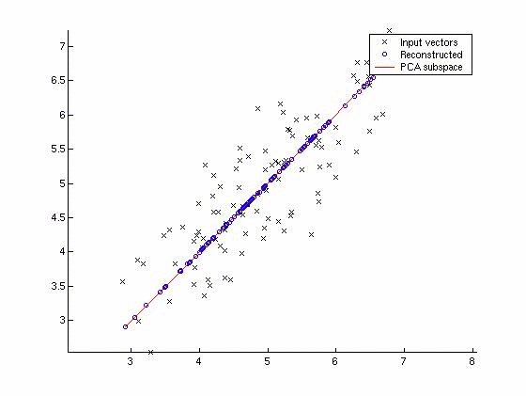
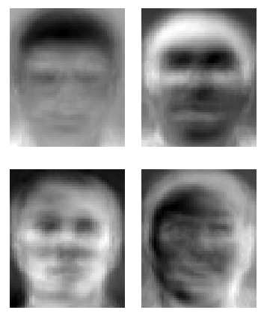
Example of Dimensionality Reduction: Principal Component Analysis
Principal component analysis (PCA) is a statistical procedure that uses an orthogonal transformation to convert a set of observations of possibly correlated variables into a set of values of linearly uncorrelated variables called principal components.
Eigen faces example for Dimension reduction

Slide 35
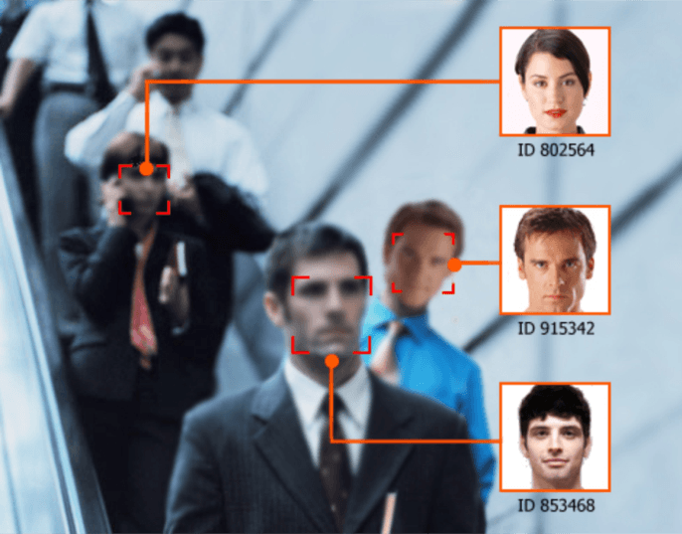
Example of Principal Component Analysis: Facial Recognition
Dimension reduction

Slide 36
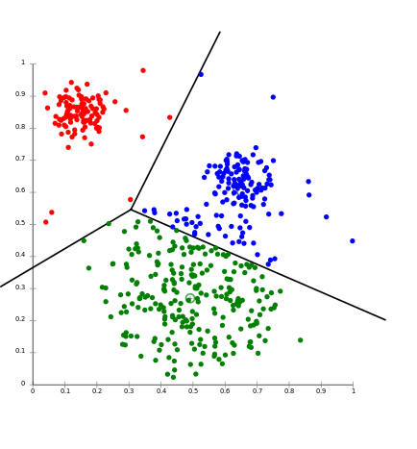
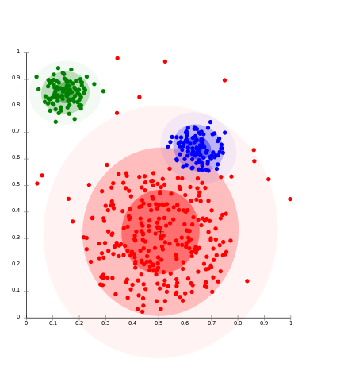
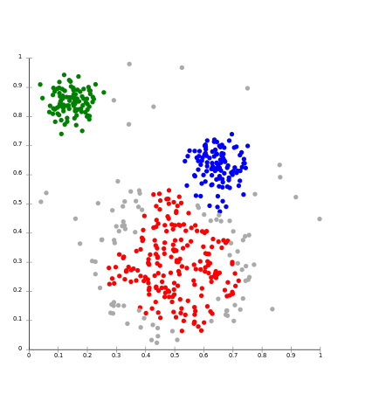
ML Techniques – Cluster Analysis
Cluster analysis or clustering is the task of grouping a set of objects in such a way that objects in the same group (called a cluster) are more similar (in some sense or another) to each other than to those in other groups (clusters).
K Means Clustering
Expectation Maximization Clustering
Density Based Clustering

Slide 37
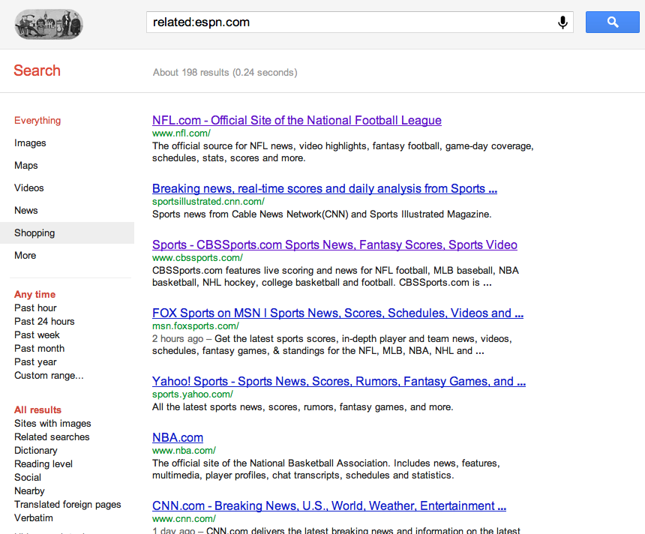
Cluster Analysis Example: Find Related Pages on Google

Slide 38

ML Techniques – Recommender Systems
Recommender systems are a subclass of information filtering system that seek to predict the 'rating' or 'preference' that a user would give to an item

Slide 39
Problems Businesses Ask
Regression
Regression/ Classification
Classification
Clustering/ Regression
Regression/ Feature Selection
What to do?
Regression
How do I account for my marketing spend?
How do I optimize marketing activity?
What is the impact of multi channel marketing?
Which marketing channels are most effective?
Which markets should I target for marketing efforts?
What is the market potential?
Where should I open my new stores?
Which customers will give me maximum revenue?
Who are the prospective customers?
How can I improve conversion rates in targeting campaigns?
How should I best target different customers?
How do customers differ in purchase behavior?
How can I retain customers pro-actively?
What is the lifetime value of the customers?
How do I measure and compare performance of new promotions?
Which are the high performance promotions?
What is the impact of different cross channel synergies on sales/profits?
How can these synergies be best leveraged?

Slide 40
Knowing the Limits
What | Why/When/ Why not?
Logistic regression | No distribution requirement Performs well with few categories categorical variables Compute the logistic distribution Good for few categories variables Easy to interpret/ computes CI Suffer multicollinearity
Decision Trees | No distribution requirement Heuristic Good for few categories variables Does not suffer multicollinearity (Choose wise)
Naïve Bayes | Generally no requirements, apart from independence Thus, suffers from multicollinarity Good for few categories variables Computes the multiplication of independent distributions
Linear Discriminant Analysis | Requires normal Not good for few categories variables Computes the addition of Multivariate distribution Computes CI Suffers multicollinearity

Slide 41
Knowing the Limits
What | Why/When/ Why not?
Support Vector Machines | No distribution requirement Computes hinge loss Flexible selection of kernels for nonlinear correlation Does not suffer multicollinearity Hard to interpret
Lasso | No distribution requirement Computes L1 loss Variable selection Multicollinearity
Ridge | No distribution requirement Computes L2 loss No variable selection Does not suffer multicollinearity
Bagging/ Boosting/ Ensemble | Boom

Slide 42
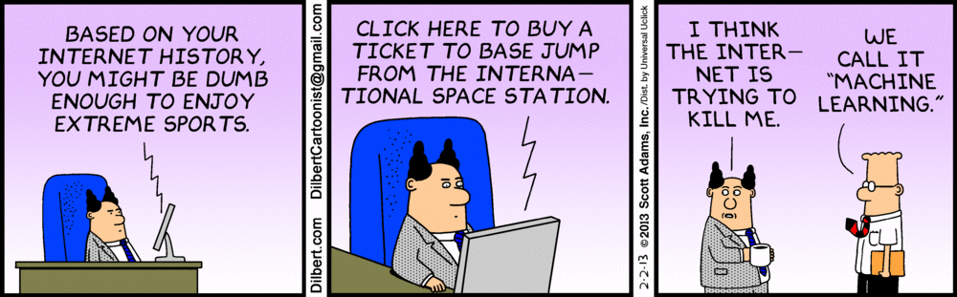
Pros and Cons of Machine Learning

Slide 43
The Good, Bad and Ugly
Pros
Cons
Useful for large scale datasets / deployment
Improved speed and accuracy
Understands the non-linearity in data and generates a functional input-output mapping
Recommended for solving classification and regression problems (e.g. better profiling of customers and their needs)
Requires significant amount of data
May not work where data collection is difficult or expensive
Problems of over-fitting if model is fitted on small datasets
Limited understanding of the machinery of classifiers (Black Box) thus difficult to explain it to the business

Slide 44
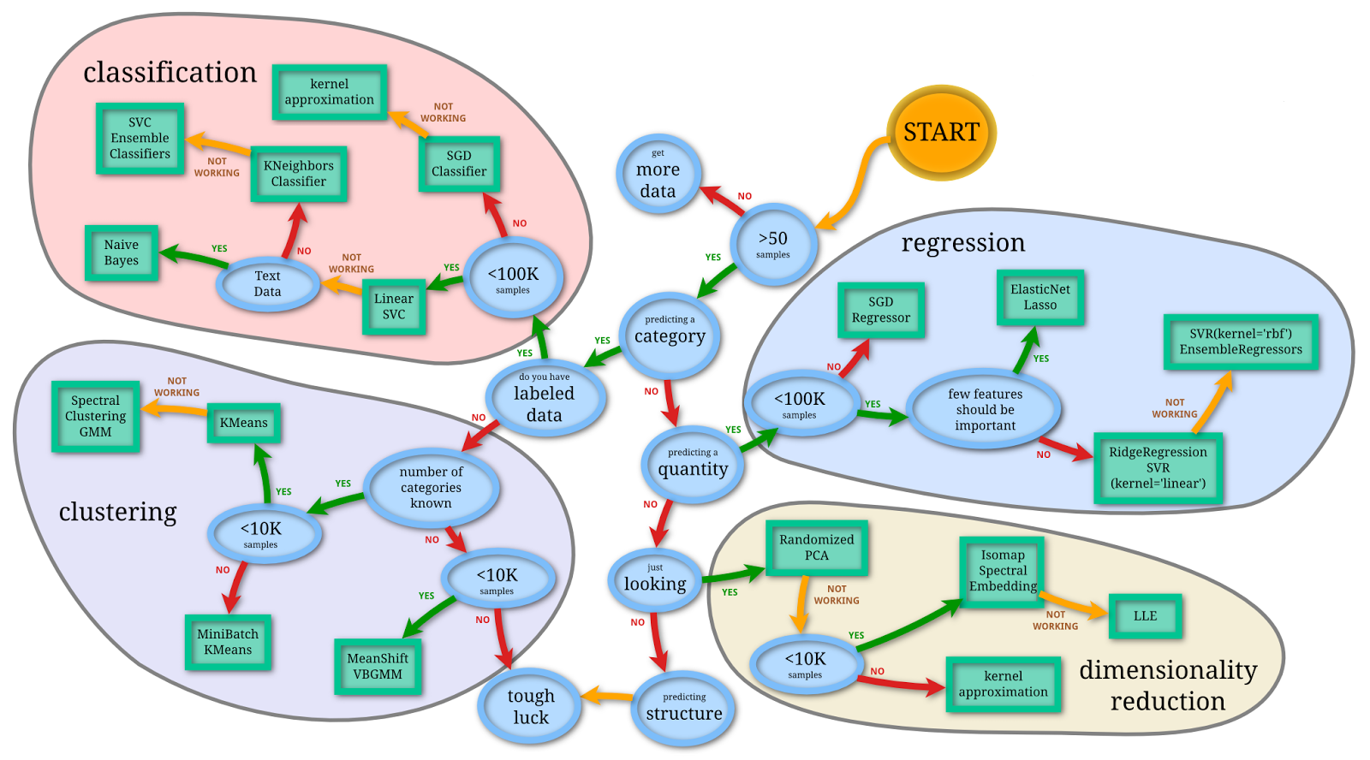
Which Technique Should I Use?

Slide 45
Basic Statistical Concepts
Standard deviation – closer look
Spearman rho
Cramer’s V
Missing value treatment
Outlier treatment
Mahalonobis distance & robust regression

Slide 46

Standard Deviation – Closer Look
Standard deviation is the square root of the variance
Standard deviation is expressed in the same units as the variables thereby helping us to understand how clustered or spread the distribution is around the mean value. Greater the value of the standard deviation, further the data tend to be dispersed from the mean
The bell curve which represents a normal distribution of data shows what standard deviation represents
One standard deviation away from the mean in either direction on the horizontal axis accounts for around 68% of the data. Two standard deviations away from the mean accounts for roughly 95% of the data with three standard deviations representing about 99%
S = √ Σ(x- x_{i})²/n
¯

Slide 47
Spearman’s Rho
Spearman’s is nonparametric measure that avoids assumptions that the variables have a straight ­line relationship
Similar to Pearson coefficient, r, Spearman’s r can have any value between –1 and +1
Some examples of situations where Spearman’s rho provides a summary of the degree to which two variables are related
When the scatter diagram shows a linear relationship between two quantitative variables, then r and r will have similar values
Ordinal data calls for non­parametric measures. Spearman’s rho measures the strength of the relationship between two ordinal variables or between an ordinal and a quantitative variable
Scatter diagram shows non­linear relationship: conventional correlation misleadingly low
Both variables – GDP & Calories are quantitative but the shape of the relationship is non­linear
The conventional correlation coefficient, r, is designed to measure the strength of relationships that are linear in nature
Here the value of r is 0.615 (61.5%), but the value of Spearman’s r is 0.796 (79.6%). The non­ linear pattern shown in the scatter diagram means that r tends to under represent the strength of the relationship
Calories
GDP

Slide 48
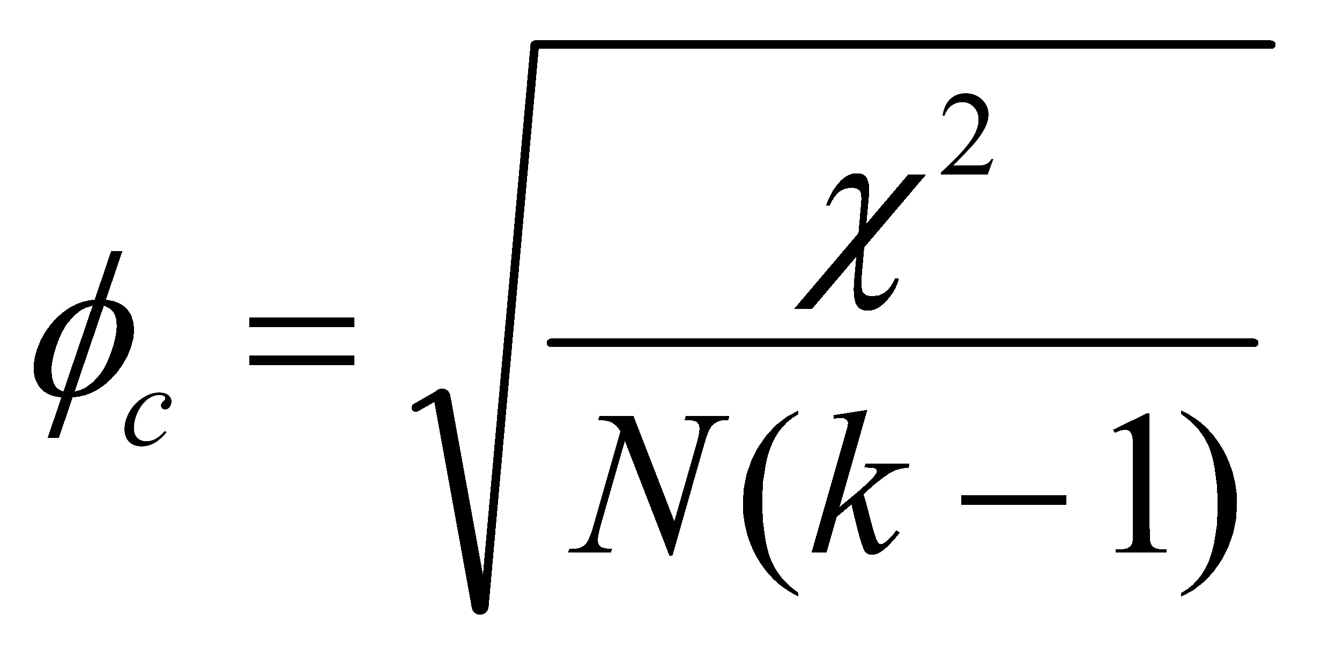
Cramer’s V
Cramer’s V is used to measure the strength of association between one nominal variable with another nominal, or ordinal variable
It is used when the number of possible values for the two variables is unequal, yielding a different number of rows and columns in the data matrix (2x3, 3x5, etc.)
Cramer’s V is computed by taking the square root of the chi-squared statistic divided by the sample size(N) and the length of the minimum dimension (k is the smaller of the number of rows r or columns c)
Cramer’s V will always fall along a range from a low of 0 to a high of 1 with negative correlation being mathematically impossible

Slide 49
Missing Value Treatment
A data set may have missing values for one or more variables. Data objects could have missing values for multiple reasons and these reasons play an important role while treating them
Following approaches may be followed to treat the missing value problem
1. Elimination
2. Imputation
Delete cases with missing values
Default method for most procedures
Results in loss of information
Process of filling in missing values of a variable
Uses available data as far as possible
Various methods exist such as substitution with
a measure of central tendency, regression based imputation, expectation maximization etc.
Upon elimination
Policy # | GEP | Policy type
001 | $100 | Life
002 | $150 | Auto
003 . . . | $200 $250 $300 $350 | - - Homeowner -
100 | $10,000 | -
Policy # | GEP
001 | $100
002 | $150
003 . . . | $200 . . .
100 | $10,000
Mean=5 is imputed
Missing values
Total # of policies : 100
Total # of policies : 70
Notes:
Imputation describes the process of filling in the missing values of a variable
Tries to use available data as far as possible.
Various imputation methods exist and can be categorized as:
Substitution with a measure of central tendency
(Out of scope::
Distribution based imputation
Tree based imputation
Regression imputation
Imputation using Expectation-Maximization algorithm
Multiple Imputation methods)

Slide 50


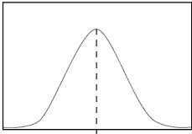
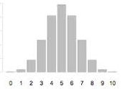
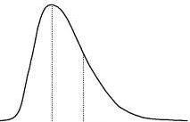
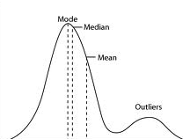
Missing Value Treatment – Imputation
Before imputation, one must ask:
What are the reasons for values to be missing?
Often, values may be found missing due to:
Non-response to a survey or dropouts
Data has been corrupted during collection and recording
A binary level (say ‘0’) has been interpreted as a missing value
If missing values are found, we can impute them on the basis of their distribution type
Distribution type
Continuous, symmetric | Discrete, symmetric | Skewed | Having many outliers
Replace with
Column mean | Mode of variable | Median | Trimmed mean
Notes:
Understanding the reasons why data are missing can help with analyzing the remaining data. If values are missing at random, the data sample may still be representative of the population. But if the values are missing systematically, analysis may be harder. For example, in a study of the relation between IQ and income, participants with an above-average IQ might tend to skip the question ‘What is your salary?’ Analysis may falsely show no association between IQ and salary, while in fact there may be a relationship. Because of these problems, methodologists routinely advise researchers to design studies to minimize the incidence of missing values.^{[1]}
Missing data can occur because of nonresponse: no information is provided for several items or no information is provided for a whole unit. Some items are more sensitive for nonresponse than others, for example items about private subjects such as income.
Dropout is a type of missingness that occurs mostly when studying development over time. In this type of study the measurement is repeated after a certain period of time. Missingness occurs when participants drop out before the test ends and one or more measurements are missing.
Sometimes missing values are caused by the researcher -- for example, when data collection is done improperly or mistakes are made in data entry.
Trimmed mean is the mean calculated after removing a small percentage of the largest and the smallest values – such measures of central tendency are less sensitive to outliers

Slide 51
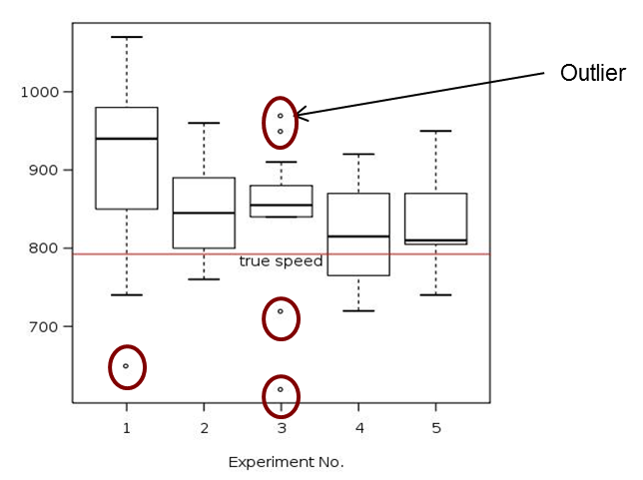
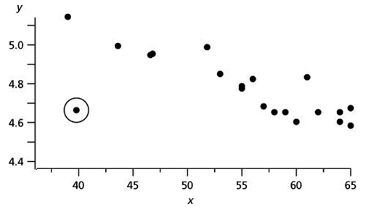
Outliers
Outliers are extreme data values deviating significantly from the rest of the sample
Types of Outlier
Description
Extreme Value Outlier
An extreme value outlier is an observation that is numerically far from the rest of the data points
Global outliers
Outlier can also exist in multivariate scenario where few observations can show abnormal behavior
Outlier
Contextual outliers
In certain business context values can be outlier if they fall beyond normal range
Ex. Age > 21 are considered outliers while reviewing in relation with height since growth normally stops after age 21
Height
Age

Slide 52
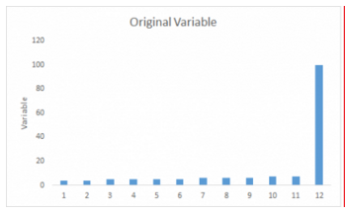
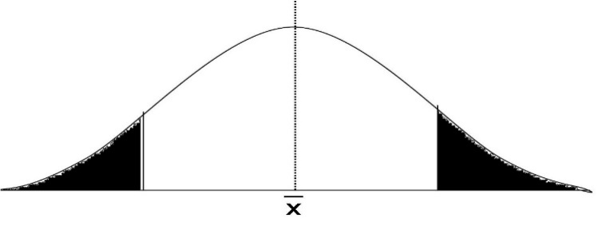
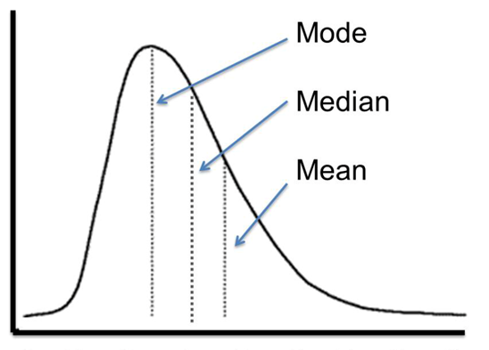
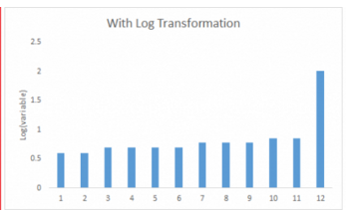
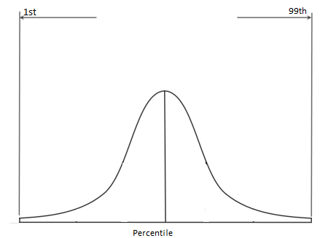
Outliers Treatments
Transform Variables
Trimming
Mean/median/mode imputation
Removing extreme values from data
Method of last resort as it leads to loss of data
Winsorizing/Capping
Central value is imputed into outlier values
Useful in reducing the impact of outliers
Log and Square root transformations are mostly used
Extreme values are replaced by some percentile value
Does not leads to loss of data

Slide 53



Outliers Treatments
Outliers should not be removed from the data without due consideration
Treatment Methods
Description
Capping / Flooring
(Sigma
Approach)
A value is identified as outlier if it exceeds the value of the 99th percentile¹or if it is below the 1st percentile of given values by some factor
Outlier capped value P99 value if they are above P99
Mahalanobis Distance Approach
To detect outlier in multivariate setting Mahalanobis distance is computed for every observation. Observations with extreme values get higher distance and given lower weight.
Weighted analysis is conducted to minimize the effect of outliers
Robust Regression Approach
To reduce impact of outlier in regression
Runs regression on the dataset and then calculate the residuals
Compute residual / MAD (Mean Absolute Deviation) and use this as weight in the model
Iterative run of the process leads to “0” weight to outliers
Notes:
http://www.nesug.org/proceedings/nesug07/sa/sa16.pdf

Slide 54

The Mahalanobis Distance
Mahalanobis distances are based on both the mean and variance of the predictor variables, plus the covariance matrix of all the variables. is a very useful way of determining the similarity of a set of values from an unknown.
Mahalanobis distance method is used is that it is very sensitive to inter-variable changes in the data and is measured in terms of standard deviations from the mean
Mahalanobis distances are calculated as:
Compared to Mahalanobis, Euclidean distance does not give any statistical measurement of how well the unknown matches
Euclidean
Mahalanobis
D² = (x-m)^{T} C⁻¹(x-m)
D² = Mahalanobis distance
x = Vector of data
m = Vector of mean values
T = Indicates vector should be transposed
C⁻¹ = Inverse covariance matrix

Slide 55
Robust Regression
Robust regression provides alternatives to an OLS* model when the data violates the fundamental assumption
This procedure dampens the influence of outliers, as compared to regular least squares estimation to provide a better fit
It is an alternative to least square method when errors are non-normal
Reasons for using robust regression
Protect against influential outliers
Useful for detecting outliers
Check results against a least squares fit
In addition to robust regression there is an another alternative to OLS called Resistant regression
Resistant regression rejects all possible outliers and is useful to detect outlier
Requires much more computing than least squares
*OLS : Ordinary least squares

